Slide 1
Debrief 17/04/23

Slide 2



Week 6: Prep for Mid-term Review
 | Monday 17 April | Tuesday 18 April | Wednesday 19 April | Thursday 20 April | Friday 21 April
10.00am to12.30pm | Corporate Project Meeting Project Sponsors 3 | Corporate Project | Job Readiness Workshop Micron Visit | Personal Growth TomoWork’s Got Talent | Digital Skills Learning
12.30pm to 2pm | Lunch Break | Lunch Break | Lunch Break | Lunch Break | Lunch Break
2pm to 4.30pm | Corporate Project | Corporate Project | Job Readiness Linkedin Clinic & Visit | Personal Growth TomoWork’s Got Talent | Digital Skills Learning
In-person session at
Republic Polytechnic
Work From Home (WFH)
Flexible arrangement
Company Visit

Slide 3
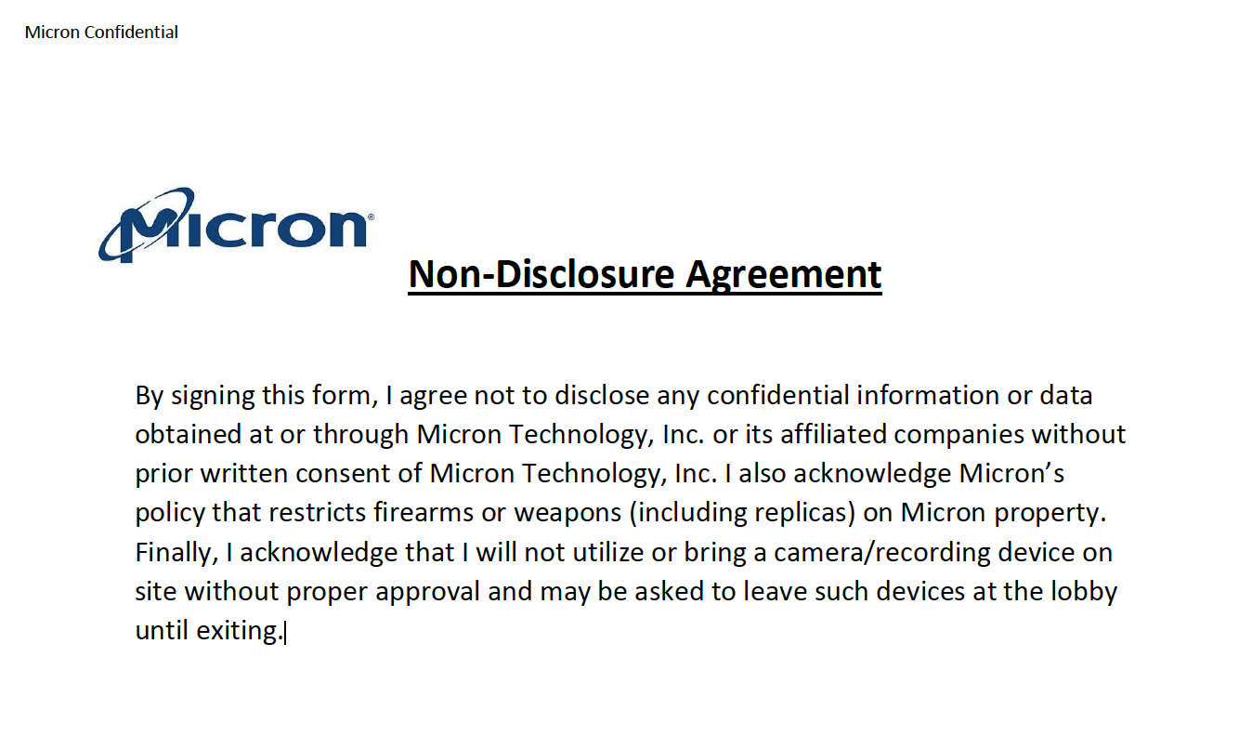
Please read this now and acknowledge that you have read it.

Slide 4
Programme for 18th April 2023 (Tuesday)
Time | Event | Venue
9.50am | Report to Republic Poly
10am -12.30pm | Corporate Project – Prep for mid-term review | E1 6T – Kinjo rubber LIBN1 – MSD LIBN2 – foodpanda LIBN3 – EVCO LIBN4 - Micron
12.30pm – 2pm | Lunch
2pm - 4pm | Corporate Project – Prep for mid-term review
4.15pm – 4.30pm | Debrief
4.30pm | Dismissal
Things to Bring: Laptop with Charger, money for lunch, comb, writing materials and handphone.
Note: Wear mask while commuting. If you are not feeling well with flu-like symptoms, please see a doctor. Even if you are recovering, please wear a mask. Clean and sanitise the area after every use.
Wear: Smart Casual

